Slide 1
SEQUENCING SCENARIO
(VERSION 15)
LRT
Stations/Transit Centers
ART
BRT
*Pre-project planning is dashed
2020
2025
2030
2035
2040
2045
2050
2055
Streetcar East Extension
Campbellton Rd LRT
Streetcar West Extension
BeltLine SW LRT
Clifton Corridor LRT***
BeltLine NE LRT
BeltLine SE LRT***
BeltLine West LRT***
Metropolitan Pkwy ART
Cleveland Ave ART
Peachtree Rd ART
Capitol Ave/Summerhill BRT
North Ave BRT
Northside Dr BRT
Greenbriar Transit Center
Moores Mill Transit Center
Station Enhancements: Bankhead/Five Points/ Vine City/Others
Local Bus Service
MARTA will consider alternative delivery methods and P3 for LRT projects
Existing Streetcar Improvements
Project sequencing will adjust as projects advance and must react to current market conditions and the availability of federal dollars
PRINT DATE: 22 May 2019
***Assumes funding gap closed
As sequenced, some LRT projects have both capital and O&M funding gaps that will need to be addressed as projects advance
Current Peak Spending Year: 2032
Phase I
Phase II
Bankhead
Five Points
Vine City
Other Station Enhancements
Notes:
This sequencing plan was approved by MARTA Board of Directors on June 13.

Slide 2
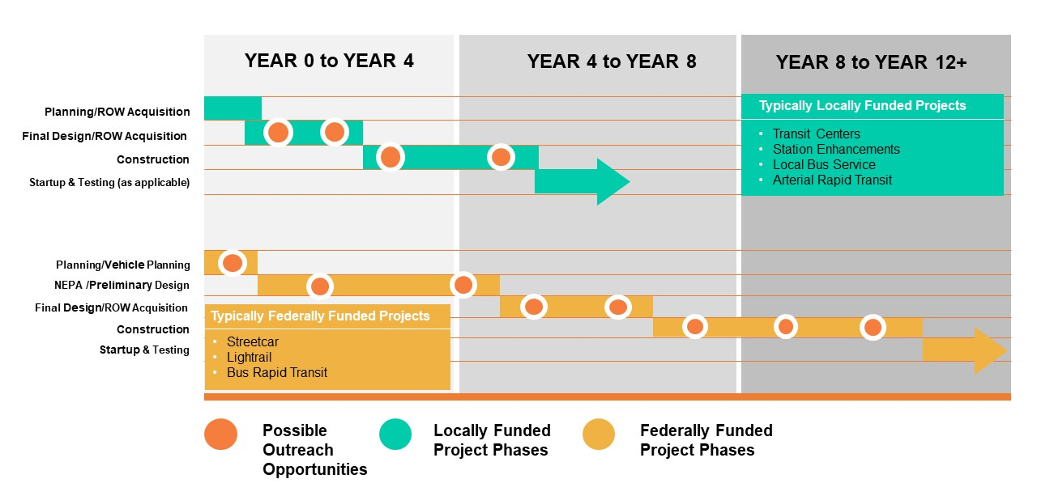
Project Delivery Process
Notes:
The majority of the More MARTA Atlanta projects will be seeking federal funding.

